Slide 1

Business Analytics II (BIS 244 – Chapter 2)
BIS 244 – Fall 2022 – Dr. Davoodi

Slide 2

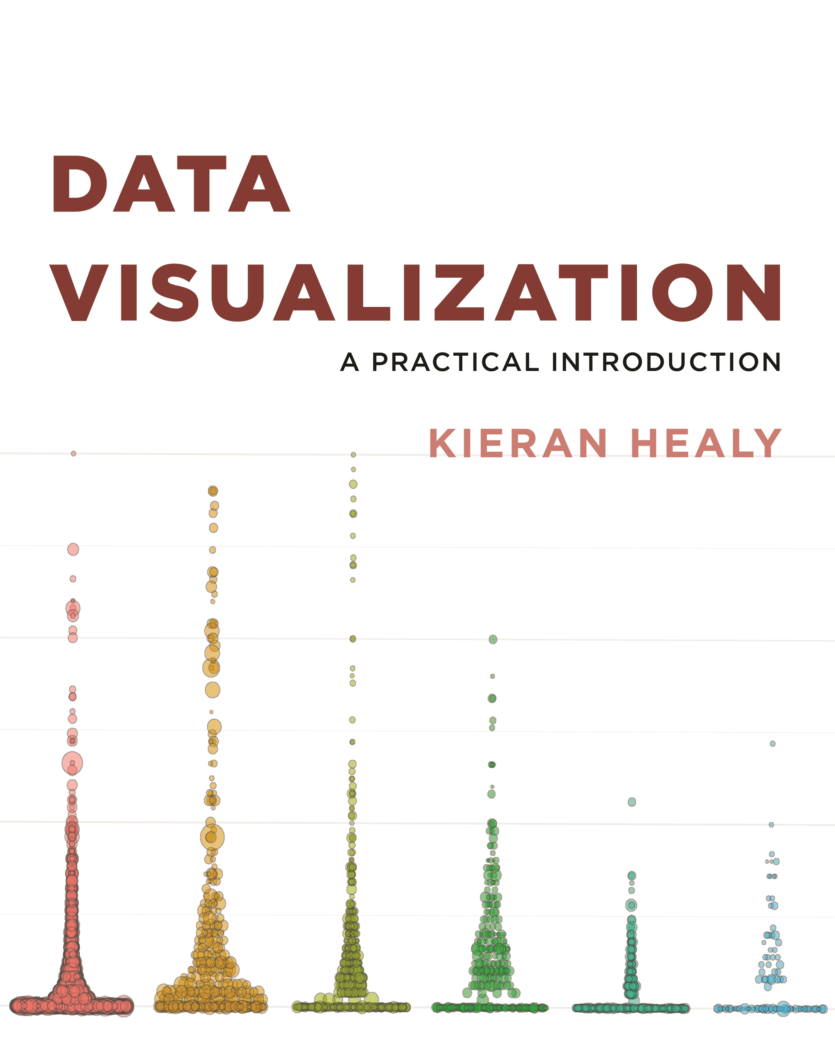
Chapter 2: Get Started
Install R, R Packages, and Review of R Commands and Functions

Slide 3
Chapter 2: Get Started
Install R
Use R with RStudio
Using RMarkdown
Install R Packages and Load a Library
Review of R Commands and Functions
Get Data into R
Make Your First Figure

Slide 4
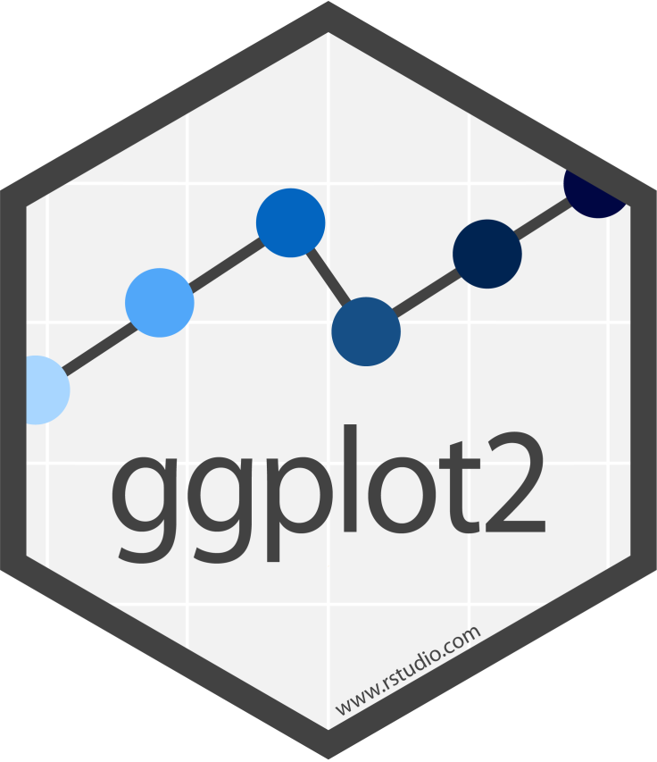

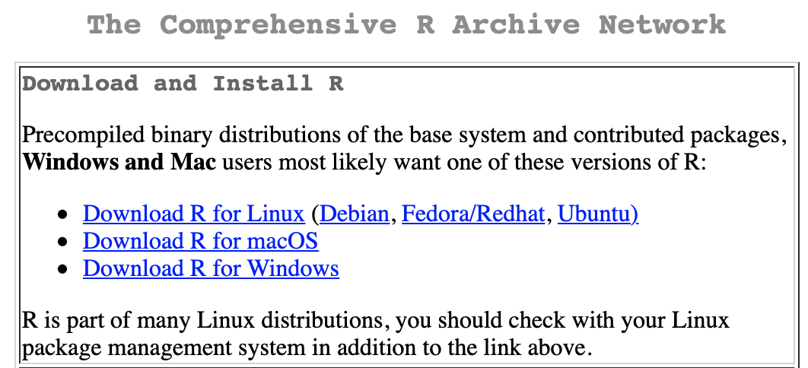
Install R
R and ggplot2 are the tools we will use.
The best way to learn them is to follow along and repeatedly write code as you go.
Install R:
1. Download the appropriate version of R:
https://www.r-project.org
2. Install R

Slide 5

Use R with RStudio
R itself is a relatively small application with next to no user interface. Everything works through a command line or console.
At its most basic, you launch it from your Terminal application (on a Mac) or Command Prompt (on Windows) by typing R.
We can make life easier for ourselves by using RStudio.
RStudio is an “integrated development environment,” or IDE.
It is a separate application from R proper.

Slide 6
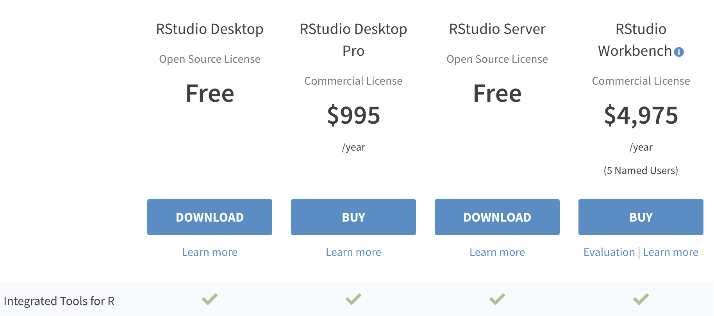
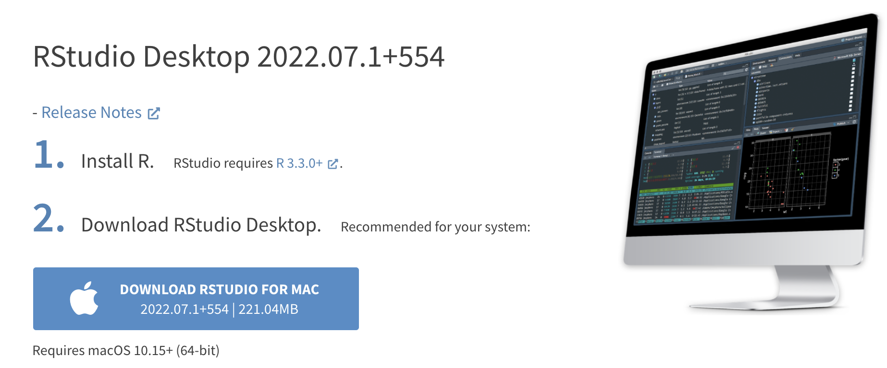
Install RStudio
Download the RStudio IDE: Choose Your Version
https://www.rstudio.com/products/rstudio/download/

Slide 7

Use R with RStudio
When launched, it starts up an instance of R’s console inside of itself.
It also conveniently pulls together various other elements to help you get your work done. These include the document where you are writing your code, the output it produces, and R’s help system.
RStudio also knows about RMarkdown and understands a lot about the R language and the organization of your project.

Slide 8
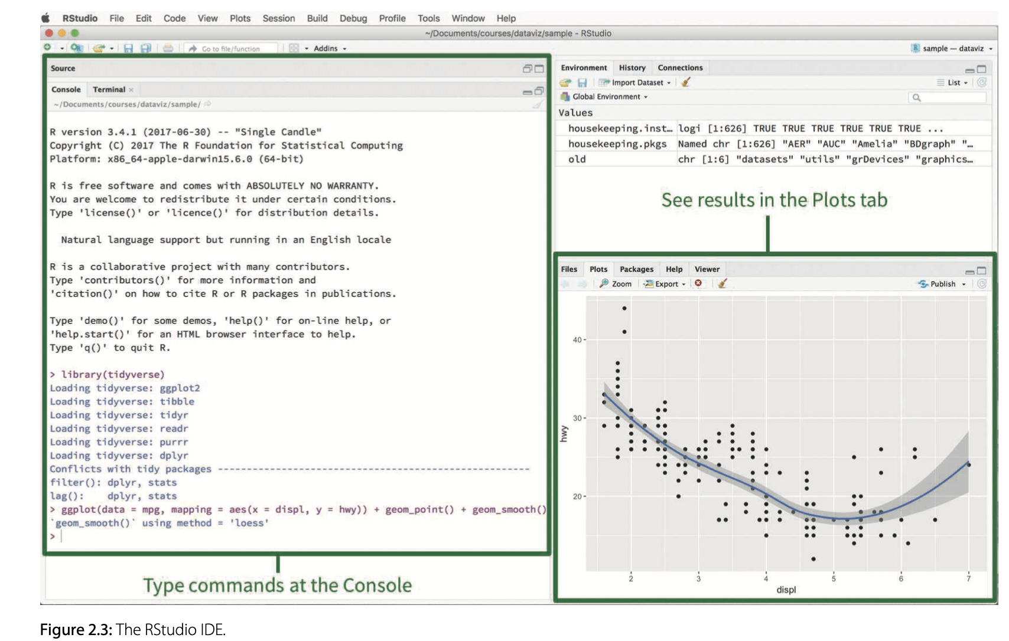
Use R with RStudio
When you launch RStudio, it should look much like figure 2.3:

Slide 9
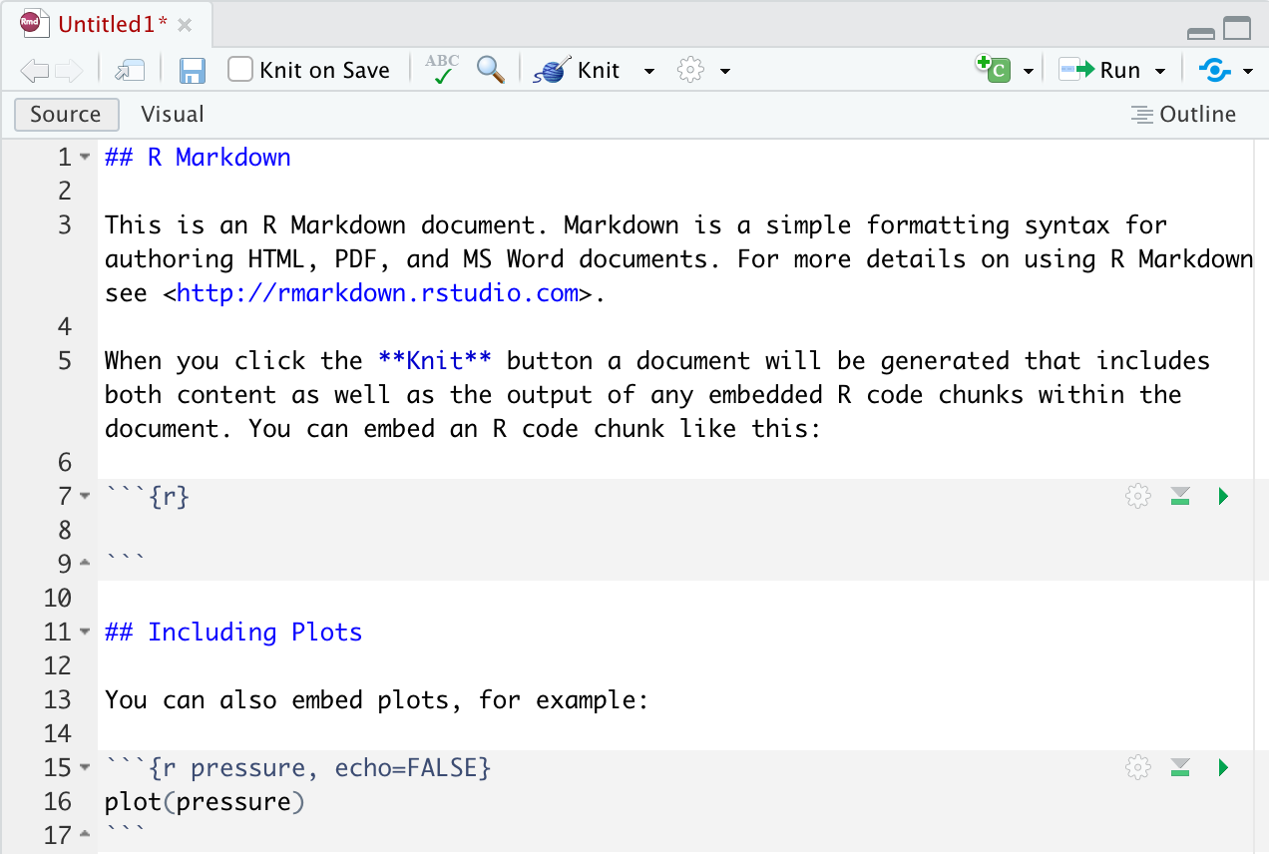
Using RMarkdown
R Markdown is a file format for making dynamic documents with R.
An R Markdown document is written in markdown (an easy-to-write plain text format) and contains chunks of embedded R code as the following:
Text
R code chunk

Slide 10
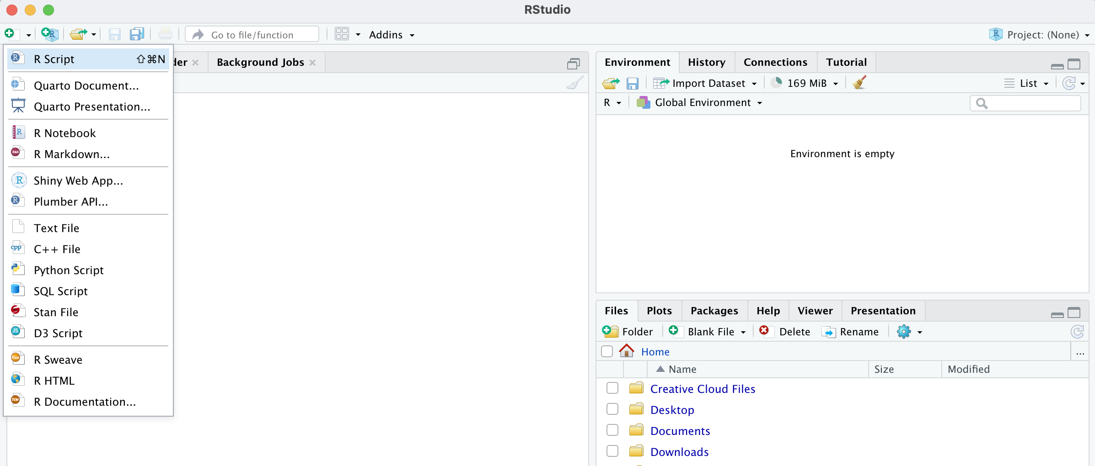
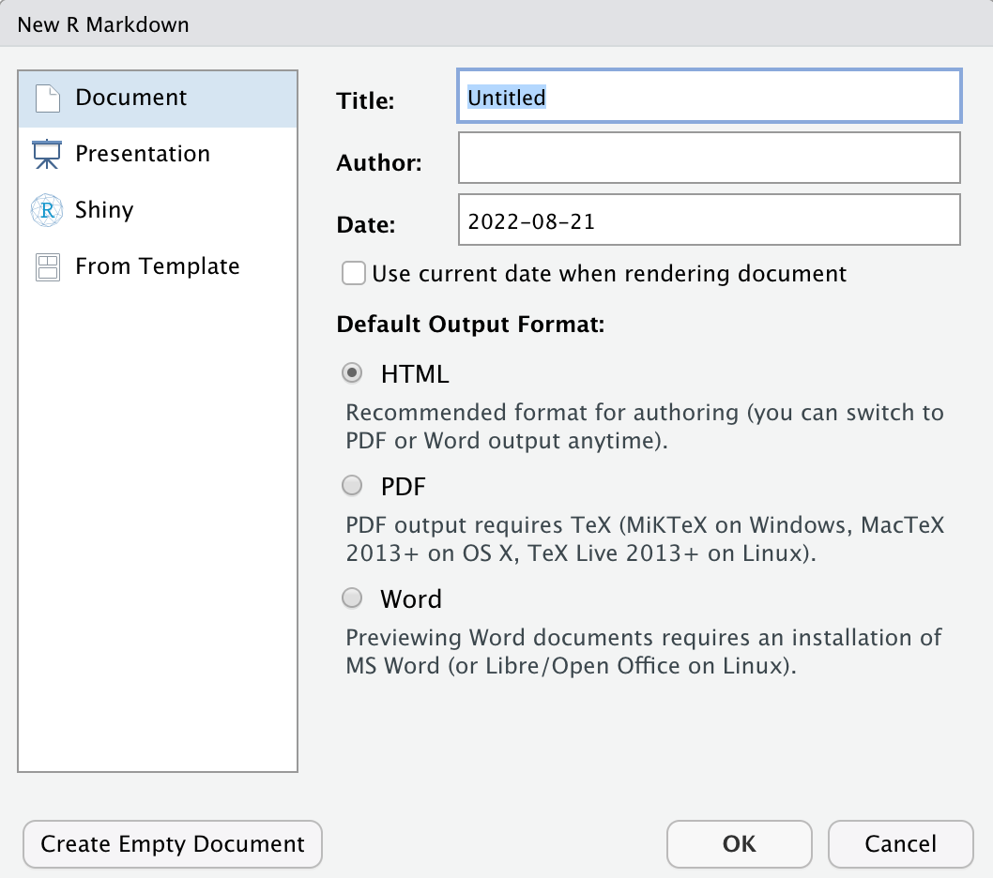
Using RMarkdown
Note: Sometimes, creating R Markdown documents requires updated versions of some packages.

Slide 11
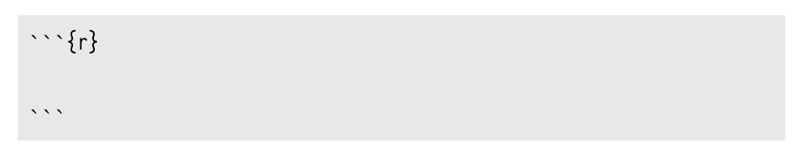
R Code Chunk in RMarkdown
Three backticks (on a U.S. keyboard, that’s the character under the escape key) are followed by a pair of curly braces containing the name of the language we are using.
The backticks-and-braces part signals that a chunk of code is about to begin. You write your code as needed and then end the chunk with a new line containing just three backticks.

Slide 12
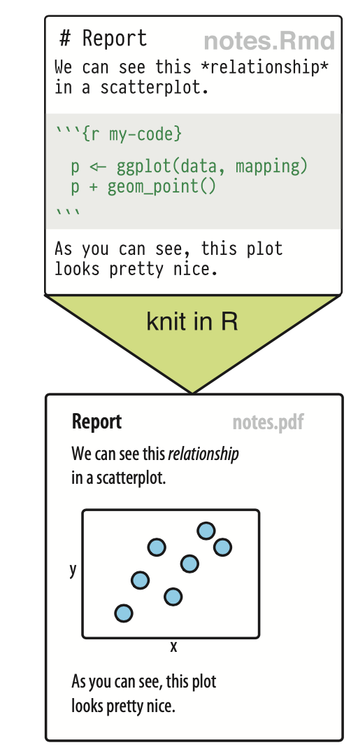
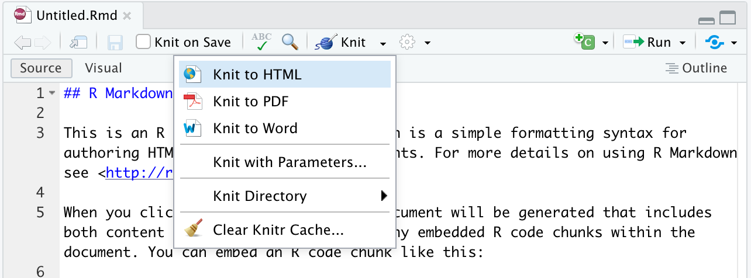
Rendering an Rmarkdown File: “Knit”
To transform your markdown file into an HTML, PDF, or Word document, click the “Knit” icon that appears above your file in the scripts editor.
A drop-down menu will let you select the type of output that you want.
When you click the button, RMarkdown will duplicate your text in the new file format.

Slide 13
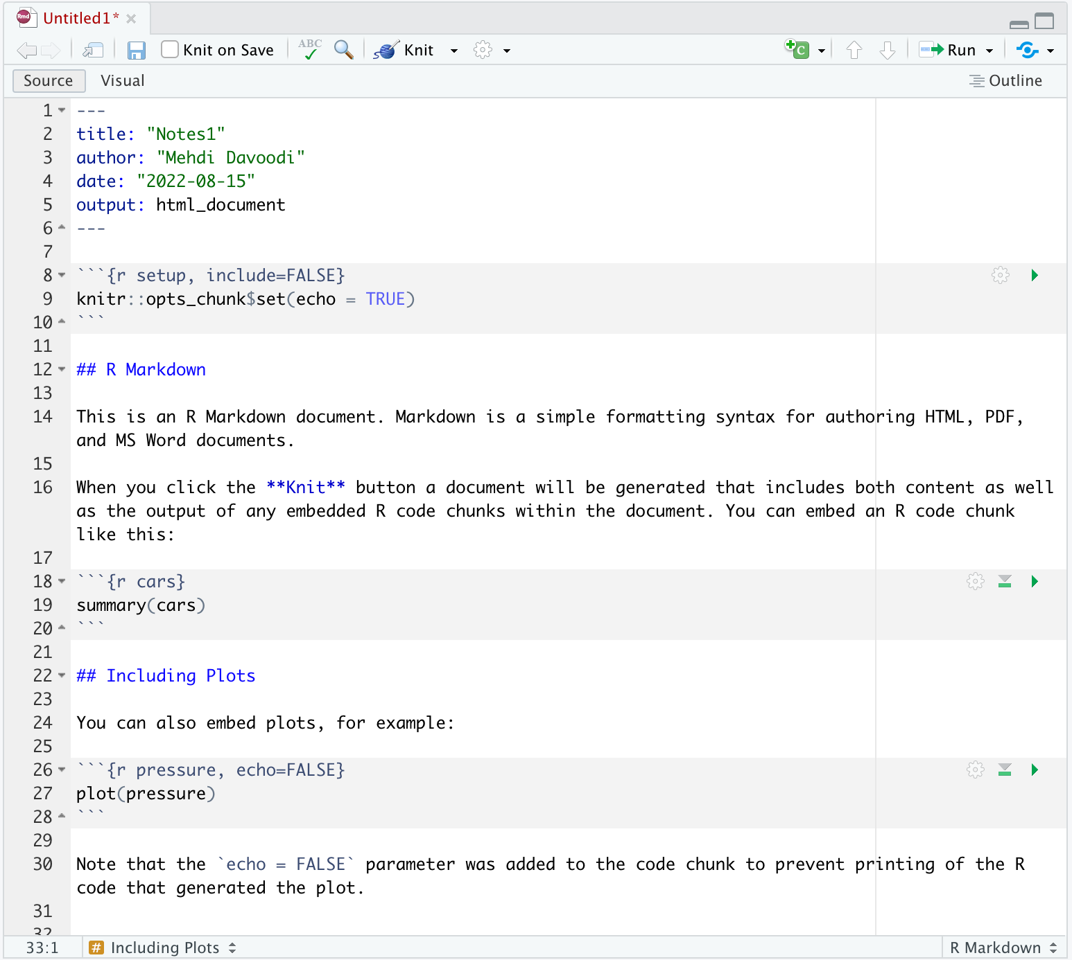
Process the whole document
An RMarkdown file in R Studio:
Information about the document
Run just this chunk
Code chunk
Notes and discussions
Run all chunks up to this chunk
Set options for this chunk
--Note: RMarkdown files conventionally end in .Rmd.

Slide 14
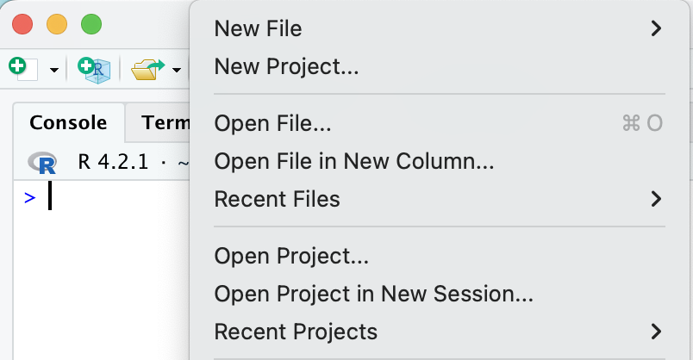
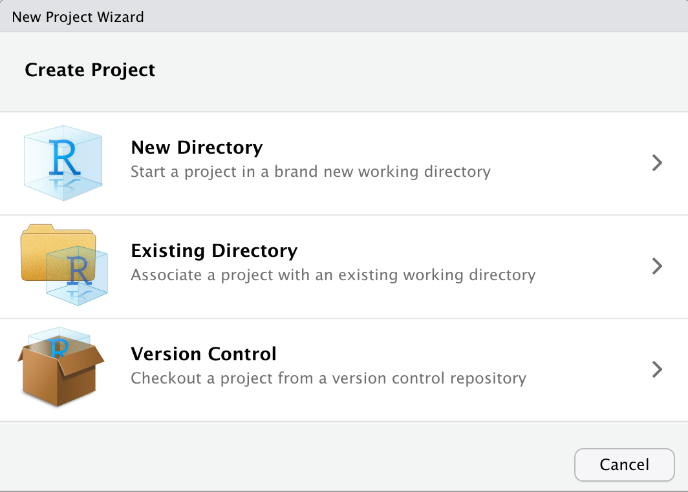
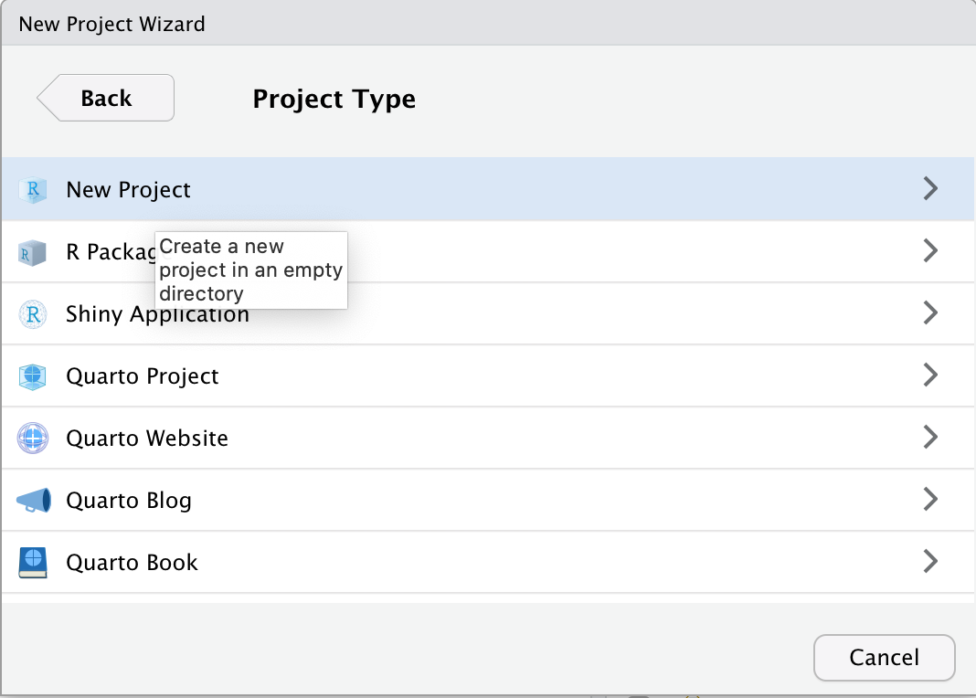
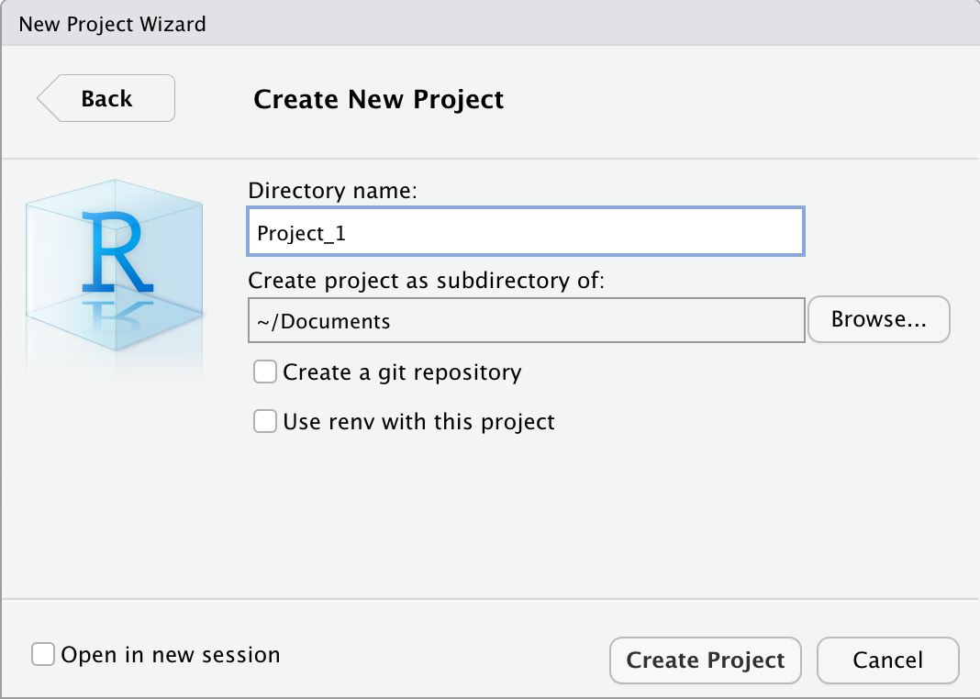
Create a Project
To begin, create a project.
From the menu, choose File > New Project ... from the menu bar, choose the New Directory option, and create the project.
Once it is set up, create an RMarkdown file in the directory, with File > New File > RMarkdown.

Slide 15
Create a Project
Keep project scripts and data in a single folder
Keep project files separate from other projects
Identifies the working directory for R

Slide 16
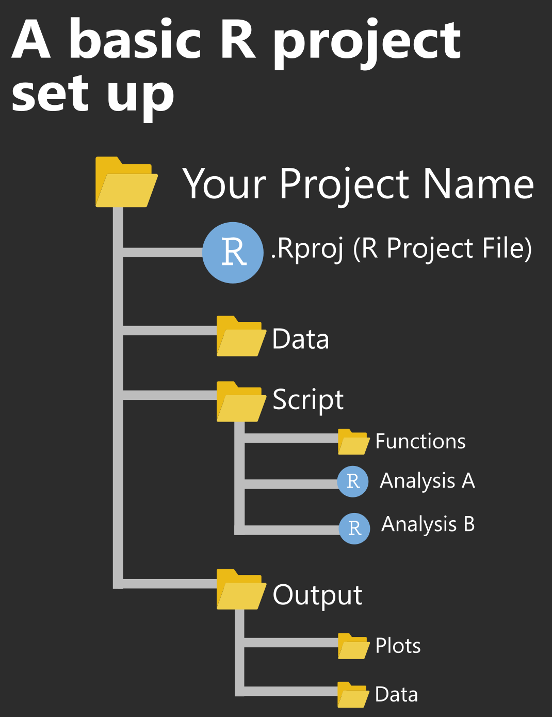
Create a Project
When your RStudio session is running through the project file (.Rproj), the current working directory points to the root folder where that .Rproj file is saved.
The mindset should be that the directory (the whole folder and its sub-folders and contents), which in other words means that you shouldn’t be reading in data from or writing data to files outside the directory.
Everything relating to that analysis or project should only happen within that directory.

Slide 17
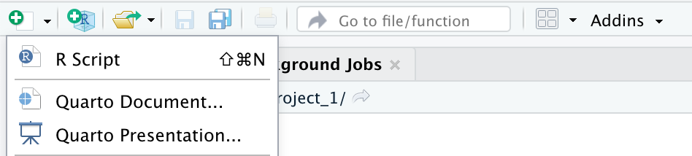
Work with an R Script File
You can create a draft of your code as you go by using an R script.
An R script is just a plain text file that you save R code in.
R script files conventionally have the extension .r or .R.
You can create an r script via File > New File > R Script.

Slide 18
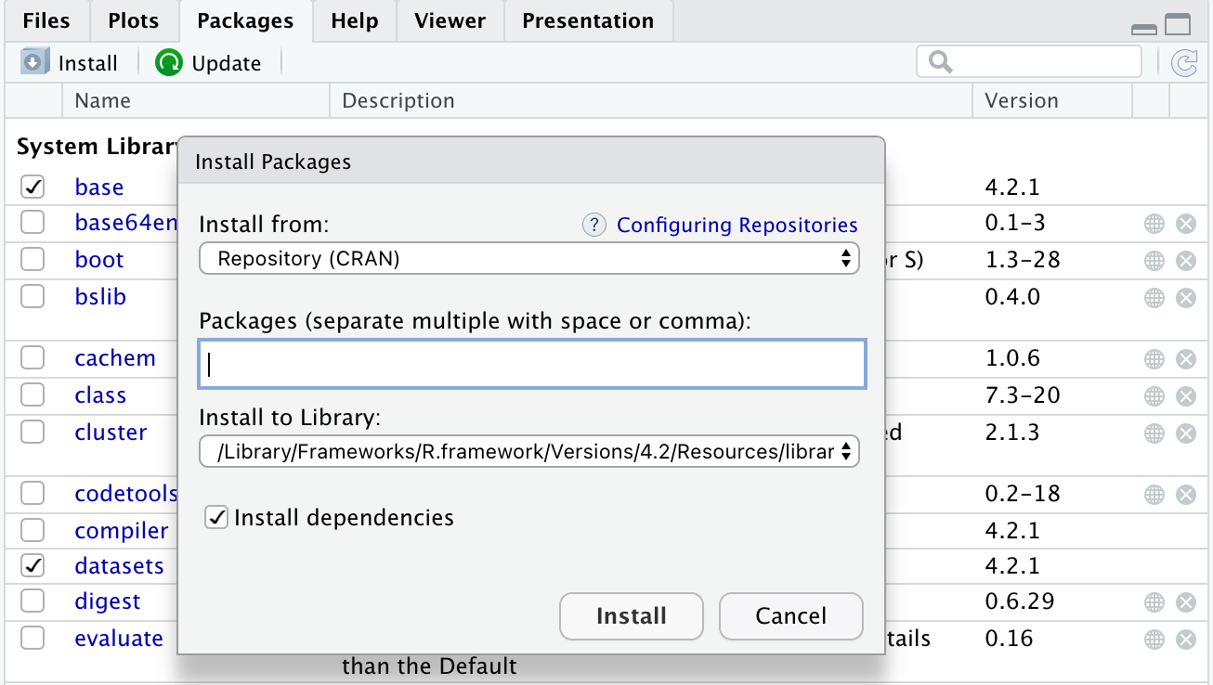
R Packages
Packages are the fundamental units of reproducible R code. They include reusable R functions, documentation that describes how to use them, and sample data.
Available CRAN Packages By Name: https://cran.r-project.org/web/packages/available_packages_by_name.html
Installing Packages
Open RStudio.
In the lower-right pane of RStudio, select the Packages tab and the Install button.
Type the name of the packages to be installed in the “Packages”.
Press Install.

Slide 19
Required R Packages for Business Analytics II (BIS 244)
To make sure you are ready to go, you need to install the following packages:
"tidyverse", "broom", "coefplot", "cowplot", "drat",
"gapminder", "GGally", "ggrepel", "ggridges", "gridExtra",
"here", "interplot", "margins", "maps", "mapproj",
"mapdata", "MASS", "quantreg", "rlang", "scales", "socviz",
"survey", "srvyr", "viridis", "viridisLite", "devtools",
"rtools","backports","vctrs"
Run “BIS244_CH2_1” R Script to install these packages.
The following are the packages Healy habitually loads into memory for each chapter:
library(gapminder)
library(here)
library(tidyverse)
library(socviz)

Slide 20
Get Started with R
In R, everything you deal with has a name. You refer to things by their names as you examine, use, or modify them. Named entities include variables (like x or y), data that you have loaded (like my_data), and functions that you use.
In R, everything is an object: Some objects are built in to R, some are added via packages, and some are created by the user. The code you write will create, manipulate, and use named objects as a matter of course.
Every object has a class. This is the sort of object it is, whether a vector, a character string, a function, a list, and so on. Knowing an object’s class tells you a lot about what you can and can’t do with it.
class(object_name)

Slide 21
Review of R Commands and Functions
Function | Purpose | Example
c() | Enter data manually to a vector | > x <- c(8, 6, 7, 5, 3, 0, 9) > x [1] 8 6 7 5 3 0 9
seq() | Generate regular sequences | > y <- seq(7, 30, 1.5) > y [1] 7.0 8.5 10.0 11.5 13.0 14.5 16.0 17.5 19.0 20.5 22.0 23.5 25.0 26.5 28.0 29.5
rep() | Replicates numeric values, or text, or the values of a vector for a specific number of times. | > hDeck <- c(rep(1, 5), rep(0, 3)) > hDeck [1] 1 1 1 1 1 0 0 0
ls() | Lists memory contents
rm() | Removes an item from memory

Slide 22
Review of R Commands and Functions
Function | Purpose | Example
data() | Load (often into a data.frame) built-in dataset | > data(iris)
names() | Lists names of variables in a data.frame | > names(iris) [1] "Sepal.Length" "Sepal.Width" "Petal.Length" "Petal.Width" "Species"
View() | View dataset in a spreadsheet-type format
dim() | See dimensions (# of rows/cols) of data.frame | > dim(iris) [1] 150 5
length() | Give length of a vector
read.csv() | Load into a data.frame an existing data file
read.table() |  | read.table(filename,header=TRUE)

Slide 23
Review of R Commands and Functions
Function | Purpose | Example
apply() | Apply function by rows or columns of a data frame or a matrix | #Using apply to find row sums: > apply(my.matrx, 1, sum) #Using apply to find length of each column: > apply(my.matrx, 2, length)
lapply() | Apply function by rows or columns of a list and returns a list
sapply() | takes list, vector or data frame as input and gives output in vector or matrix
as.data.frame() | check if an object is a data frame, or coerce it to a data frame if possible
as.double() | Convert integer to double class.

Slide 24
Review of R Commands and Functions
Function | Purpose | Example
all() | Check whether all values of a logical vector are TRUE | > x1 <- c(1, 5, 3, - 3, 5, - 7, 8) > all(x1 < 0) [1] FALSE
any() | Check whether any values of a logical vector are TRUE | > any(x1 < 0) [1] TRUE
is.data.frame () | Test if object is a data frame
sort() | Return input in ascending or descending order | > x <- c(4, - 10, 8, 0) > sort(x) [1] -10 0 4 8
write() | Write data to files
write.xlsx() | Export data frame from R to Excel workbook. | > write.xlsx(data, "data.xlsx")

Slide 25
Review of R Commands and Functions (Statistical)
Function | Purpose | Example
summery() | Display 5-number summary and mean: Min, 1st Quartile, Median, Mean, 3rd Quartile, Max. | > summary(x)
mean() | Identify “center” of distribution | > mean(x, na.rm = FALSE) ** na.rm is used to remove the missing values from the input vector.
median() |  | > median(x, na.rm = TRUE)
var() | Find variance, the standard deviation of values in a vector | > var(x)
sd() |  | > sd(x)
sum() | Add up all values in a vector
quartile() | Find the position of a quantile in a dataset | >quantile(x, probs=seq(0, 1, .2), na.rm=T) ** na.rm is used to remove the missing values from the input vector. **probs: numeric vector of probabilities with values in [0,1]: 0% 20% 40% 60% 80% 100%

Slide 26
Get Data into R
Before we can plot anything at all, we have to get our data into R in a format it can use.
Cleaning and reading in your data is one of the least immediately satisfying pieces of an analysis.
This is the reason that many of the datasets for our reference book are provided in a preprepared form via the socviz library rather than as data files you must manually read in: The socviz library comes with a small RMarkdown template that follows the structure of this book.

Slide 27
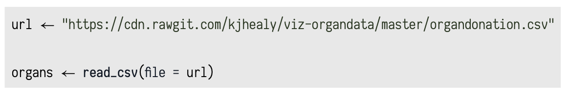
Get Data into R
Use the read_csv() function to read in “comma-separated” data.
This function is in the readr package, one of the pieces of the tidyverse.
Note: The "tidyverse" collects some of the most versatile R packages: ggplot2, dplyr, tidyr, readr, purrr, and tibble. The packages work in harmony to clean, process, model, and visualize data.
Example: We can tell read_csv() to fetch data for us from an URL and put it in an object named organs:

Slide 28
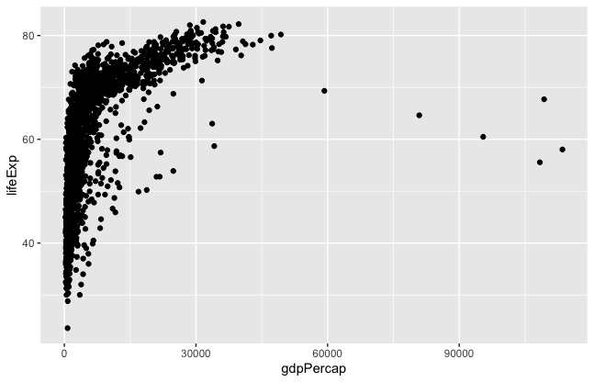
Make Your First Figure
Since the goal of this course is not to teach you all about R but just how to produce good graphics, we can postpone a lot of details until later.
We will start by using a function to make a named object and plot the result.
Use the gapminder dataset.
Load the data and take a look.
Make a scatterplot
library(gapminder)
# Examine gapminder data set
gapminder
# Make a Scatterplot
p <- ggplot(data = gapminder, mapping = aes(x = gdpPercap, y = lifeExp))
p + geom_point()
Notes:
We will use the Gapminder dataset, which you should already have available on your computer. We load the data with library() and take a look.

Slide 29
Summary
Installing R and using R with RStudio
RMarkdown and creating a project in RStudio
Review some R commands and functions
Read data and make our first plot

